Slide 1
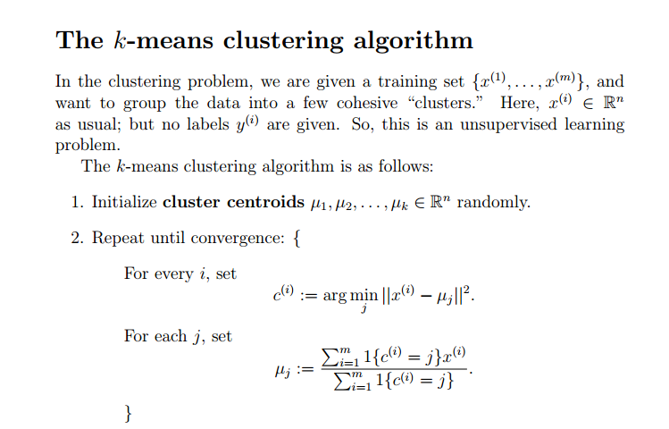

Slide 2
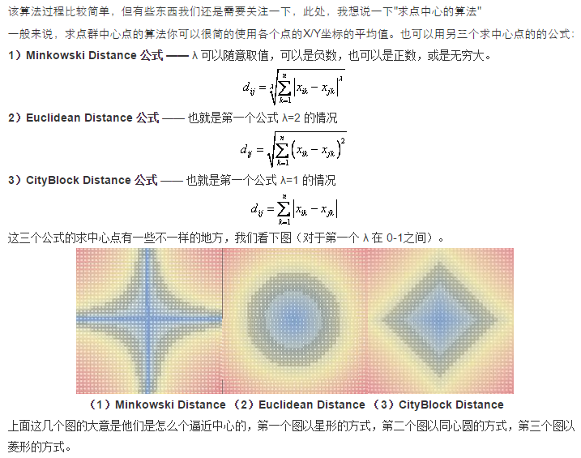

Slide 3
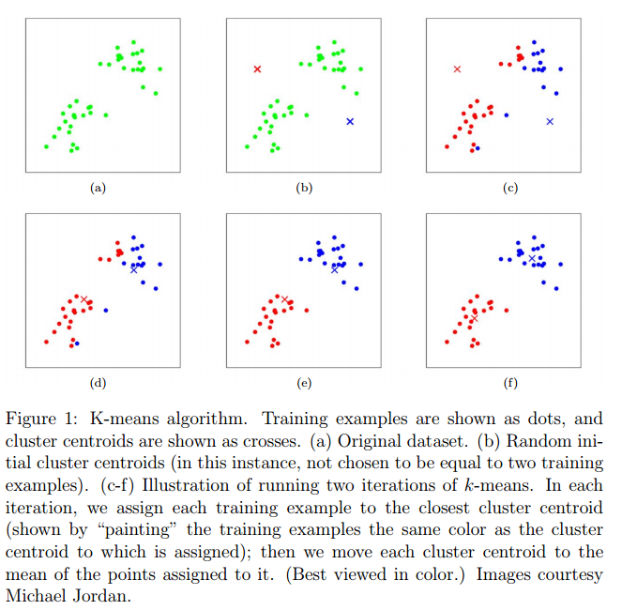

Slide 4

The distortion function J is a non-convex function, and so coordinate descent on J is not guaranteed to converge to the global minimum.

Slide 5


Slide 6
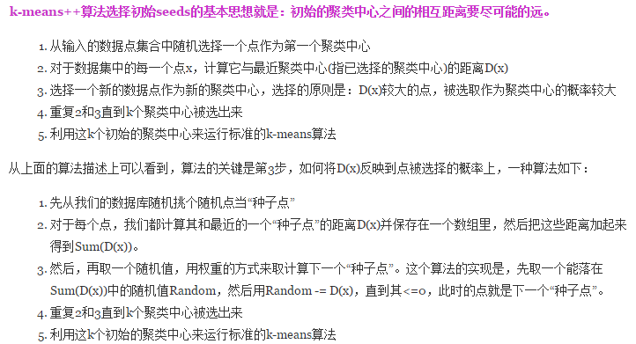

Slide 7
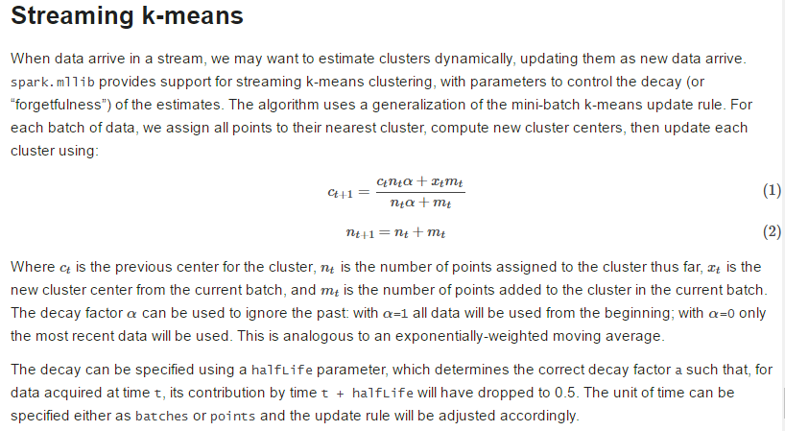

Slide 8


Slide 9
